Slide 1


The optimal of COVID-19 vaccine in U.S.
MSIS 638
Jialiang ma

Slide 2
Agenda
Topics
Scope / Purpose
Vaccine Information
Assumption
Methodology
Results

Slide 3
Scope and Purpose
This presentation will focus on determining the comprehensive utility of vaccines and which one will be a better choice in U.S.
The scope focuses on the utility of each vaccine available in Boston during the pandemic in 2021,
find out the optimal solution based on comparison.
Data: Mass.gov, CDC website, WHO website, vaccines white papers, and journals.

Slide 4
Vaccine Available Types
1. Pfizer (95%), (2 Dosage)
2. Moderna (94%), (2 Dosage)
3. Johnson & Johnson (72%), (1 Dosage)

Slide 5
Comprehensive Assumption
Constraints and limitations
- Vaccines are currently the most effective way to prevent the pandemic. <Max>
Narrow the scope of applicants to the Massachusetts, U.S. <Min>
Excluding the people with special allergies history, pregnant , age under 18, and infected by HIV before. <Min>
Limitation: Environment (without further virus mutation) <Min>

Slide 6
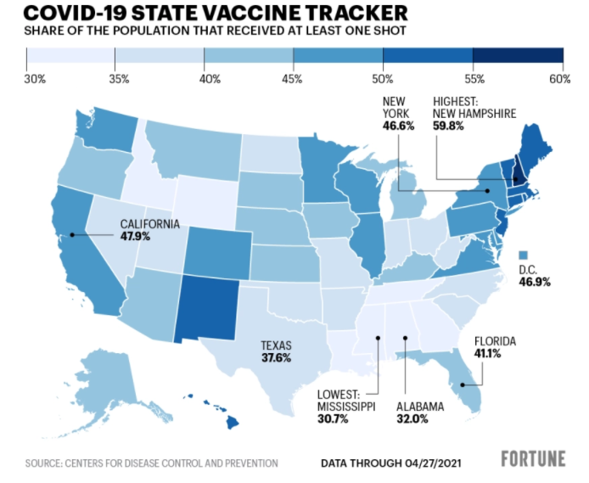

Slide 7
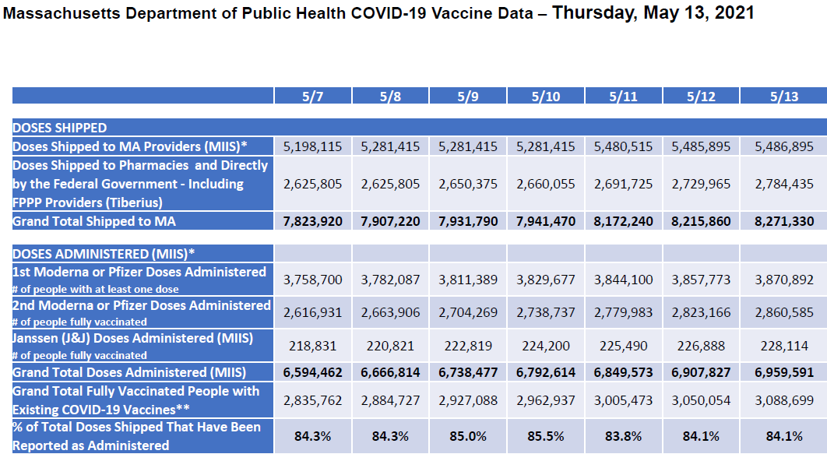

Slide 8
Solution: Weighted Average Model
Criterion / Parameters - Purpose
Efficacy: 7
Potential Risk: 6
Storage management / condition: 4
Other positive effect: 5
Side effects: 7
Dosage: 4
Structure: 4
Apart time: 3

Slide 9
Weighted on Each Alternatives
Pfizer
Efficacy: 95%
Potential Risk: Medium
Storage management / condition: Medium (2~8°C) <5D>
Other positive effect: Have the chance to deal with South Africa variant strains.
Side effects: High
Dosage: 2
Structure: mRNA (new generation) < SARS CoV-2>
Apart time: 28D
Moderna
Efficacy: 94%
Potential Risk: Medium
Storage management / condition: Easy (2~8°C) <30D>
Other positive effect: None (still under experimenting)
Side effects: Medium
Dosage: 2
Structure: mRNA-1273 (new generation) < SARS CoV-2>
Apart time: 24 to 42D (33D as average)
Johnson & Johnson
Efficacy: 72%
Potential Risk: High (causing blood clots)
Storage management / condition: Easy (2~8°C)<35D>
Other positive effect: Have the chance to deal with South Africa variant strains and other common diseases.
Side effects: Light
Dosage: 1
Structure: carrier (current generation)
Apart time: 0D (no apart time)

Slide 10
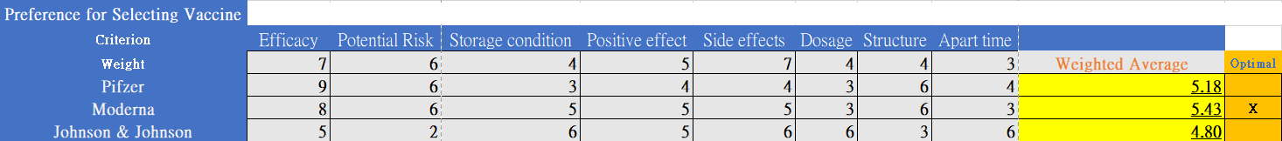
Testing the results
After conducting the model, the results shows that Moderna has the highest weight, which is 5.43
We still need to adjust our model indexes through sensitivity analysis to have a closer fit to the purpose.

Slide 11
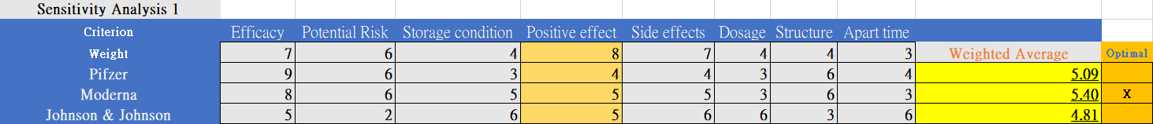
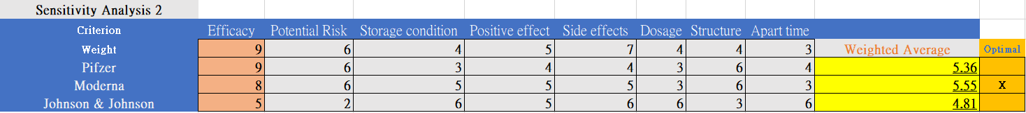
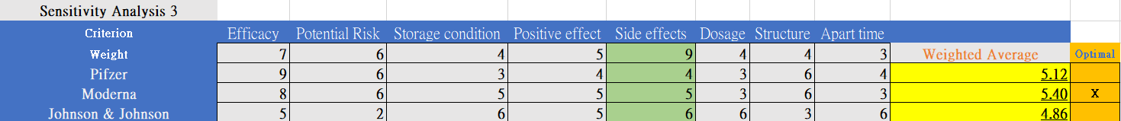
Sensitivity Analysis I

Slide 12
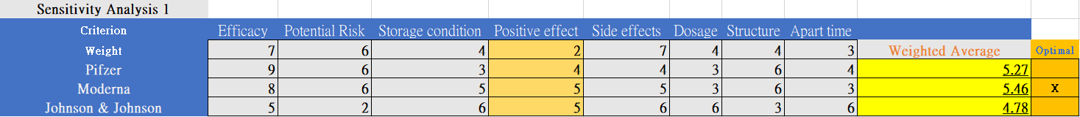
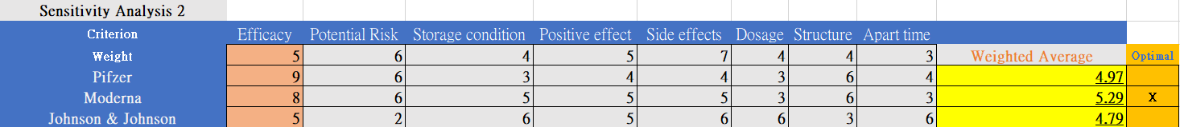
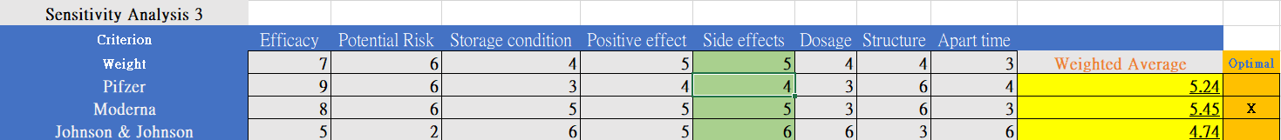
Sensitivity Analysis II

Slide 13
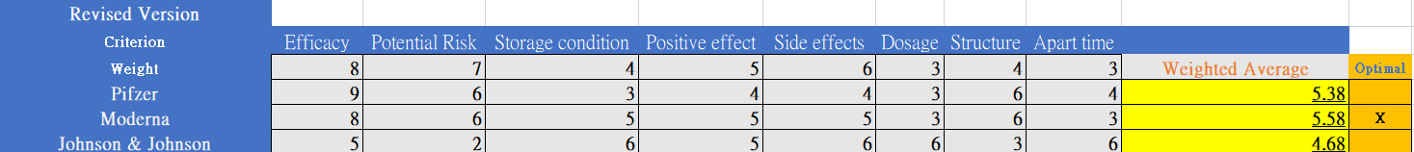
Revised Results / Recommendation
- High efficacy, side effects, and low potential risk parameters have high correlation with the model.
- Through sensitivity analysis, the model can avoid the problem of uneven weight distribution, with accurate output.
- The use-case model can reflect the current vaccinees development and clinical trials data completion.

Slide 14

Thank You For Listening

